Slide 1
Unsupervised and Explainable Text Generation Evaluation
Lei Li
Joint work with Wenda Xu, Xian Qian, Mingxuan Wang, Danqing Wang, Liangming Pan, Zhenqiao Song, Markus Freitag, William Wang

Slide 2
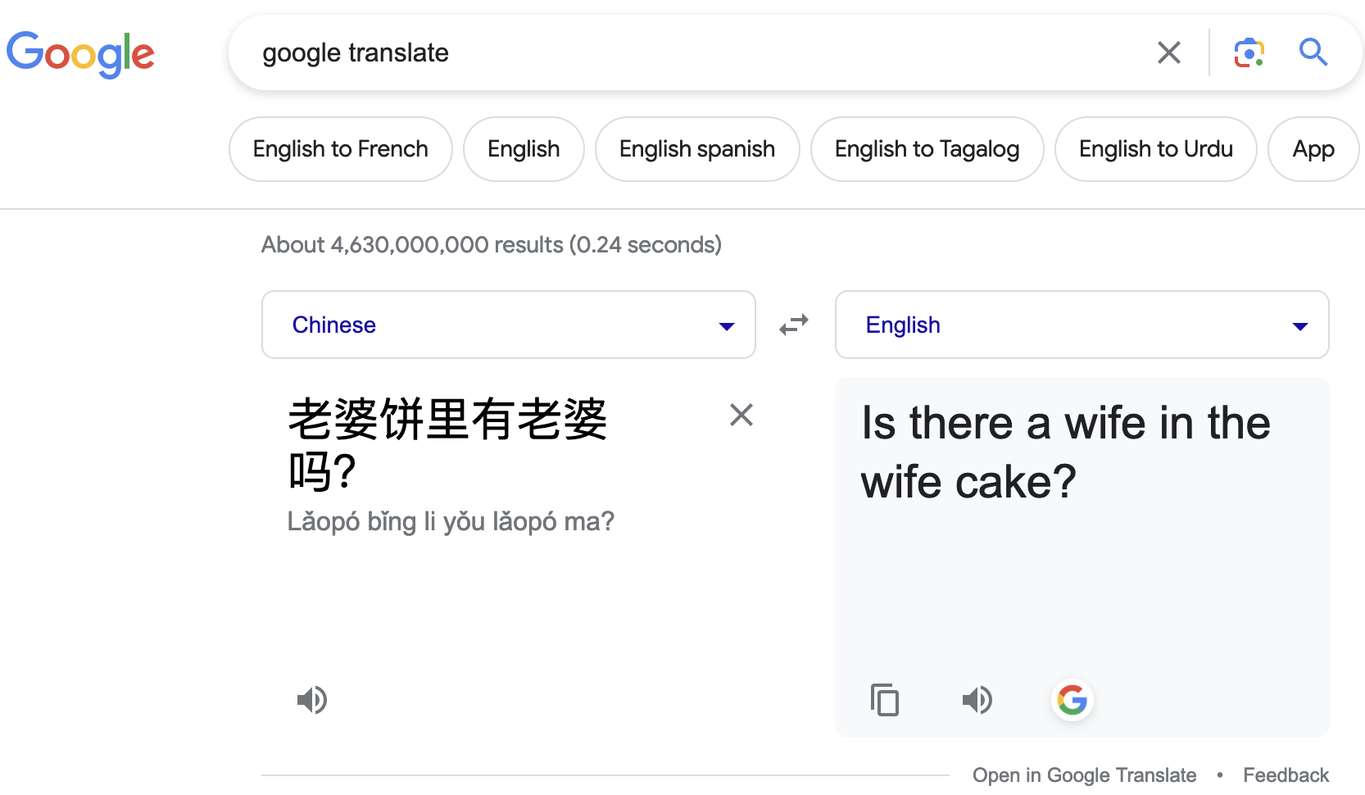

Is Google translate right?
The correct translation is:
The The correct translation is:
translation is
The correct translation is:
Wife cake != Sweetheart cake
Is there a wife in the Sweetheart cake?

Slide 3
What does InstructScore comment on this mistake?
Output: Is there a wife in the wife cake?
Reference: Is there a wife in the Sweetheart cake?
Your Translation contains 1 error:
Error type 1: Terminology is non-standard or does not fit context. Terminology is used inconsistently
Major/minor: Major
Error location 1: "wife cake"
Explanation for error 1: The term "wife cake" is not the standard term for this food, which is "sweetheart cake".

Slide 4

What if we don’t understand target language?
Reference: Diese Vakuumpumpe mit Mehrfachbetrieb hat einen speziellen
Output: Diese mehrfach angetriebene Vakuumpumpe verfügt über einen speziellen Griff
Your Translation contains 2 errors:
Error type 1: Incorrect translation is missing content from the correct translation
Major/minor: Major
Error location 1: "mit Mehrfachbetrieb" is missing in the incorrect translation
Explanation for error 1: The incorrect translation omits the important information that the vacuum pump is multifunctional, which changes the meaning of the sentence.
……

Slide 5
NLG Evaluation: Observations and Challenges
In the age of LLMs, no matter what you work on, it boils down to EVALUATION.
In the past, even though everyone knows the limitations of BLEU, people still used it for MT for 20 years. It was even used in dialogue, data-to-text generation, and many other tasks.
I argue that people can no longer use it anymore: the fundamental advantage of LLMs is the long and diverse output (OOD), and with long/diverse outputs, BLEU/ROUGE will have significantly decreased correlations with human judgments.

Slide 6
Rule-based vs Learned Metric
Rule-based
Supervised Metric
Unsupervised Metric
Score
Score
Human rating
Score
Rules
Model
Model
Ref or Src
Candidate
Ref or Src
Candidate
Ref or Src
Candidate
Notes:
A set of predefined rules
Advantage: fast, easy to use, can be extended to different domain
Exclude rule-based metrics
Combine rule-based into unsupervised, include existing metrics

Slide 7

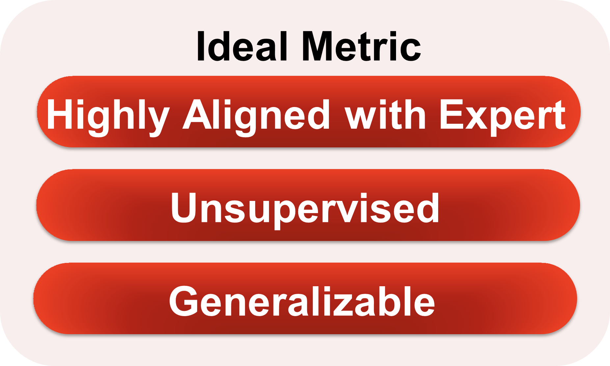

Challenge: Learning Unsupervised Metric
Data Scarcity - lack of large annotated human ratings
<He is a dog person, He is a cat person, -5>
Deviation from expert ratings
Lack of Generalization Capability
WMT rating data – 400K

Slide 8

Rule-based vs Learned Metric
Rule-based
Supervised Metric
Unsupervised Metric
BLEU
chrF
TER
ROUGE
BLEURT
COMET
BERTScore
PRISM
BARTScore
Overfitting
Deviate from human judgements
Surface form difference
Notes:
Limitations for baseline metrics (knowledgeable about all relevant works)

Slide 9
SEScore1&2: Unsupervised Metric
Identify individual errors in the model outputs and Judge severity level of each error
Use data without human ratings to train a text generation metric
Large-scale synthetic data pretraining
SEScore: Learning Text Generation Metrics using Stratified Error Synthesis (Xu et al., EMNLP 2022)
SEScore 2: Retrieval-Augmented Error Synthesis (Xu et al., ACL 2023)
Notes:
Two fonts

Slide 10

Our proposed method – SEScore1&2
Raw Corpus
Synthesized Text
Perturbations
Severity Measures
Synthetic Quality Score
Notes:
Let us simulate human errors and have simulated scores

Slide 11
Our proposed method - SEScore
Raw Text
Synthesized Text
Synthetic Quality Score
Train from Synthetic Triples
Quality Prediction Model
Notes:
Let us simulate human errors and have simulated scores

Slide 12
Our proposed method - SEScore
At Inference
Reference
Quality Prediction Model
Score
Candidates
Notes:
Let us simulate human errors and have simulated scores

Slide 13
Can we mimic those error types and grading?
Reference: He will not accept it because he will not like it
Candidate Text: will He accept it because he hates the plan he will not fancy it
Human Score: -16
Notes:
Fonts: error types

Slide 14
Can we synthesize realistic model mistakes?
2/1/2023
NLP lab / Computer Science Department / UC Santa Barbara
Notes:
It is my great pleasure to present this work at Bytedance So today, I not only want to discuss this new text generation evaluation metric, SEScore, but also I would like to have some discussions about building an ideal evaluation metric and address some research questions along this line as well. Let us get to it.

Slide 15
Stratified Error Synthesis Overview (SEScore1)
Raw text (x_{raw}): He will not accept it because he will not like it
Insert
Step1 Insertion: He will not accept it because he hates the plan he will not like it
Major
Notes:
Fonts: error types
Animation of inserts, delete, replace and swap
Severe, Minor

Slide 16
Stratified Error Synthesis Overview (SEScore1)
Raw text (x_{raw}): He will not accept it because he will not like it
Step1 Insertion: He will not accept it because he hates the plan he will not like it
Delete
Step2 Deletion: He will accept it because he hates the plan he will not like it
Major
Notes:
Fonts: error types
Animation of inserts, delete, replace and swap
Severe, Minor

Slide 17
Stratified Error Synthesis Overview (SEScore1)
Raw text (x_{raw}): He will not accept it because he will not like it
Step2 Deletion: He will accept it because he hates the plan he will not like it
Replace
Step3 Replace: He will accept it because he hates the plan he will not fancy it
Minor
Notes:
Fonts: error types
Animation of inserts, delete, replace and swap
Severe, Minor

Slide 18
Stratified Error Synthesis Overview (SEScore1)
Raw text (x_{raw}): He will not accept it because he will not like it
Step3 Replace: He will accept it because he hates the plan he will not fancy it
Swap
Step4 Swap: will He accept it because he hates the plan he will not fancy it
Major
Notes:
Fonts: error types
Animation of inserts, delete, replace and swap
Severe, Minor

Slide 19
SEScore2: synthesize realistic errors with retrieved examples at various severity levels
Random: Rescaling the statement by the raccoon of the Council
Minor: Rescales the statement by the President of the Council
Major: Rescaling the statement by the President of the security Council
Pivot: Rescaling the statement by the President of the Council

Slide 20
Stratified Error Synthesis Overview (SEScore1)
Raw text (x_{raw}): He will not accept it because he will not like it
Step1 Insertion: He will not accept it because he hates the plan he will not like it
Major
Step2 Deletion: He will accept it because he hates the plan he will not like it
Major
Step3 Replace: He will accept it because he hates the plan he will not fancy it
Minor
Step4 Swap: will He accept it because he hates the plan he will not fancy it
Minor
Notes:
Fonts: error types
Animation of inserts, delete, replace and swap
Severe, Minor

Slide 21
Stratified Error Synthesis Overview
Raw Text Reference: He will not accept it because he will not like it
Synthesized Text: will He accept it because he hates the plan he will not fancy it
Synthetic Quality Score: -16
Notes:
Fonts: error types

Slide 22

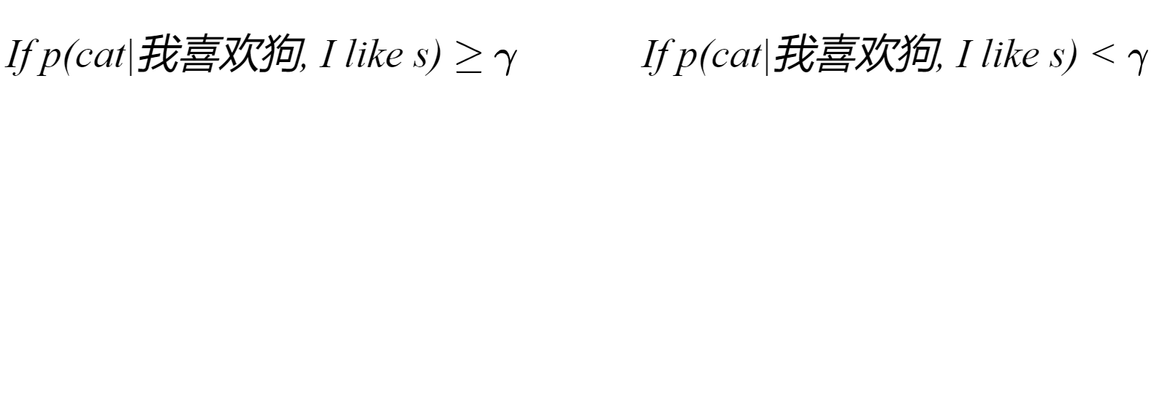
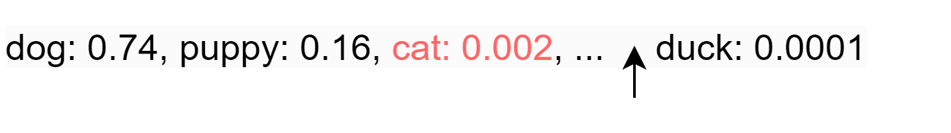
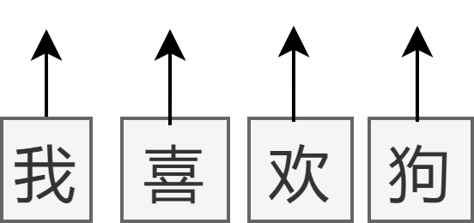
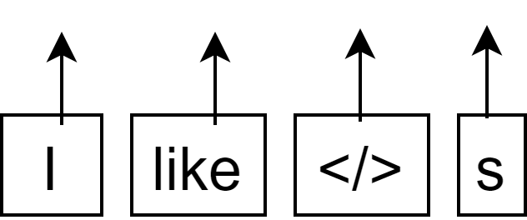


Severity Measure pipeline

Slide 23
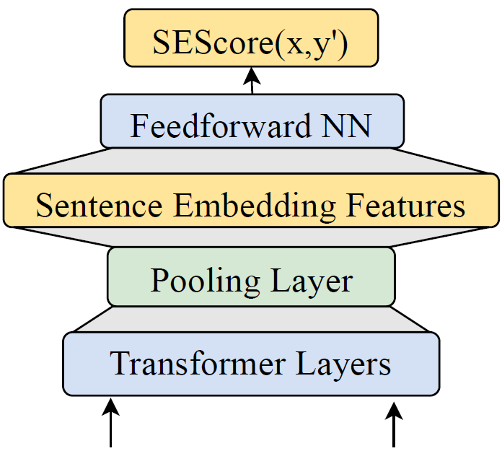
Quality Prediction Model (Training)
MSE
Synthetic Quality Score: -5
He is a dog person He is a cat person
(Raw Text) (Synthesized Text)
He is a dog person He is a cat person
(Raw Text) (Synthesized Text)
Notes:
Put text example and scores (two slides)
Training and inference

Slide 24
Quality Prediction Model (Inference)
Score: -0.5
(Very positive Score!)
He is a dog person He likes dogs
(Reference) (Candidate Text)

Slide 25
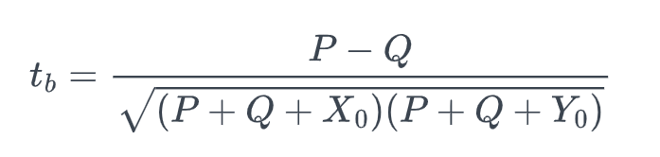
Experimental Setup
Benchmark | # sys | # per sys
WMT21 En-De News | 15 | 527
WMT21 Zh-En News | 17 | 650
WMT21 De-En News | 10 | 100
WMT21 En-De TED | 15 | 529
WMT21 Zh-En TED | 14 | 529
IWSLT22 En-Ja | 4 | 118
BAGEL Dialogue | - | 202
WebNLG Data-to-Text | 17 | 177
Testing Datasets
WMT21(MQM) Machine Translation En-De, Zh-En, De-En
WebNLG20 Data-to-Text
IWSLT22 Speech Translation En-Ja
BAGEL Dialogue Generation
Correlation to Humans
Segment-level Kendall Correlation
Kendall Formulation

Slide 26
Experimental Details
It takes 10 mins to generate 5M sentences (64 CPUs)
use RemBERT as backbone
batch size: 256, learning rate: 3e-5 and dropout rate: 0.15
 | Index Table |  | Pretraining Data
Language | News | Wikipedia | # Anchor | # Retrieved
English | 20M | 20M | 5M | 13.5M
German | 4.5M | 16M | 4.5M | 13.2M
Japanese | 18M | 12M | 5M | 13.3M

Slide 27
Do we need separate metrics for each text generation task?
NLP lab / Computer Science Department / UC Santa Barbara
Notes:
It is my great pleasure to present this work at Bytedance So today, I not only want to discuss this new text generation evaluation metric, SEScore, but also I would like to have some discussions about building an ideal evaluation metric and address some research questions along this line as well. Let us get to it.

Slide 28
SEScore1&2 can be used to evaluate Machine Translation

Slide 29
SEScore1&2 can be used to evaluate Machine Translation
Notes:
Reverse the order

Slide 30
SEScore1&2 can be used to evaluate Speech Translation

Slide 31
SEScore1&2 can be used to evaluate Data-to-Text

Slide 32
SEScore1&2 can be used to evaluate BAGEL Dialogue

Slide 33
How about SEScore1&2’s overall performance?

Slide 34
Do we need separate metrics for same target language Machine Translation directions?
2/1/2023
NLP lab / Computer Science Department / UC Santa Barbara

Slide 35
SEScore1&2 can be used to evaluate Y->X (en) directions

Slide 36
SEScore1&2 can be used to evaluate Y->X (en) directions

Slide 37
Do we need separate metrics for each domain of the same language and task?
NLP lab / Computer Science Department / UC Santa Barbara
Notes:
It is my great pleasure to present this work at Bytedance So today, I not only want to discuss this new text generation evaluation metric, SEScore, but also I would like to have some discussions about building an ideal evaluation metric and address some research questions along this line as well. Let us get to it.

Slide 38
SEScore1&2 can be used to evaluate different domains

Slide 39
SEScore1&2 can be used to evaluate different domains

Slide 40

Can existing metrics correlate with experts?
Reference: However, Boston Dynamics pointed out that Spot has now entered mass production, and most of its subscribers were construction and energy companies.
Ouput 1: However, Boston Dynamics Technology pointed out that Spot has entered the stage of mass production, and most of the buyers are construction and energy operators. (MQM: -3)
Output 2: However, Boston Power Technology pointed out that Spot has now entered the stage of mass production, and most of the subscribers are construction and energy companies. (MQM: -6)
BLEU BERTScore PRISM COMET BLEURT SEScore

Slide 41
Why does SEScore1&2 work?
1. Is fine-tuning dangerous for learned metrics?
2. Is retrieval augmented synthesis better than random token perturbations?
3. Is severity measure important?
4. How to interpret SEScore1&2?

Slide 42
Is fine-tuning dangerous for metrics?
Benchmark | News | TED | Overall | Difference
COMET | 0.300 | 0.240 | 0.270 | 0.060
BLEURT | 0.305 | 0.243 | 0.274 | 0.062
SEScore2+FT | 0.312 | 0.229 | 0.271 | 0.083
SEScore2 | 0.287 | 0.265 | 0.276 | 0.022

Slide 43
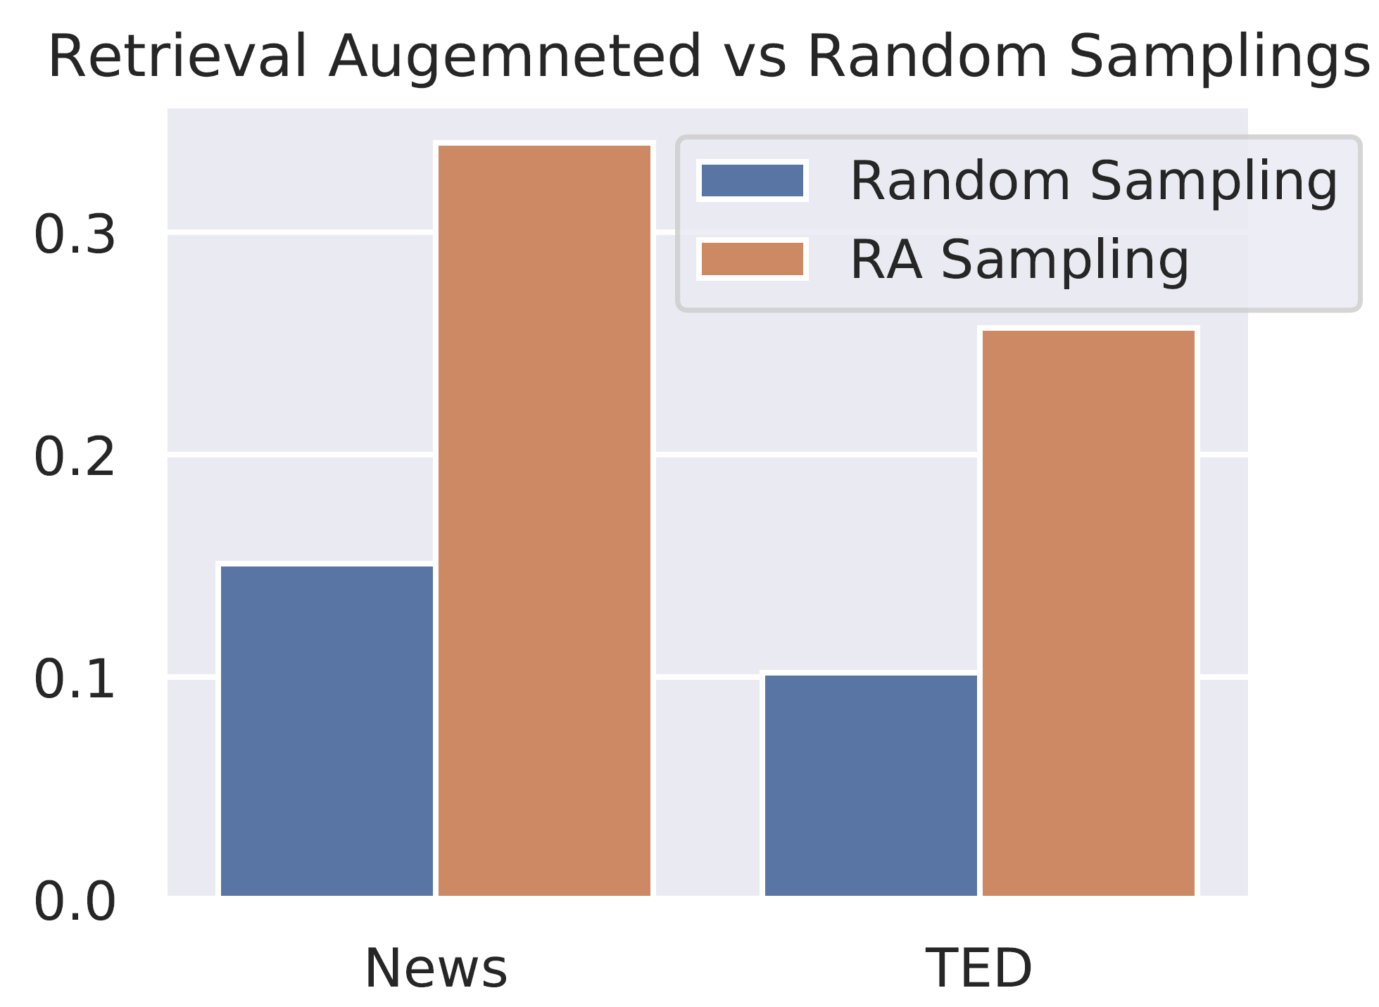
Is retrieval augmented synthesis better than random token perturbations?

Slide 44
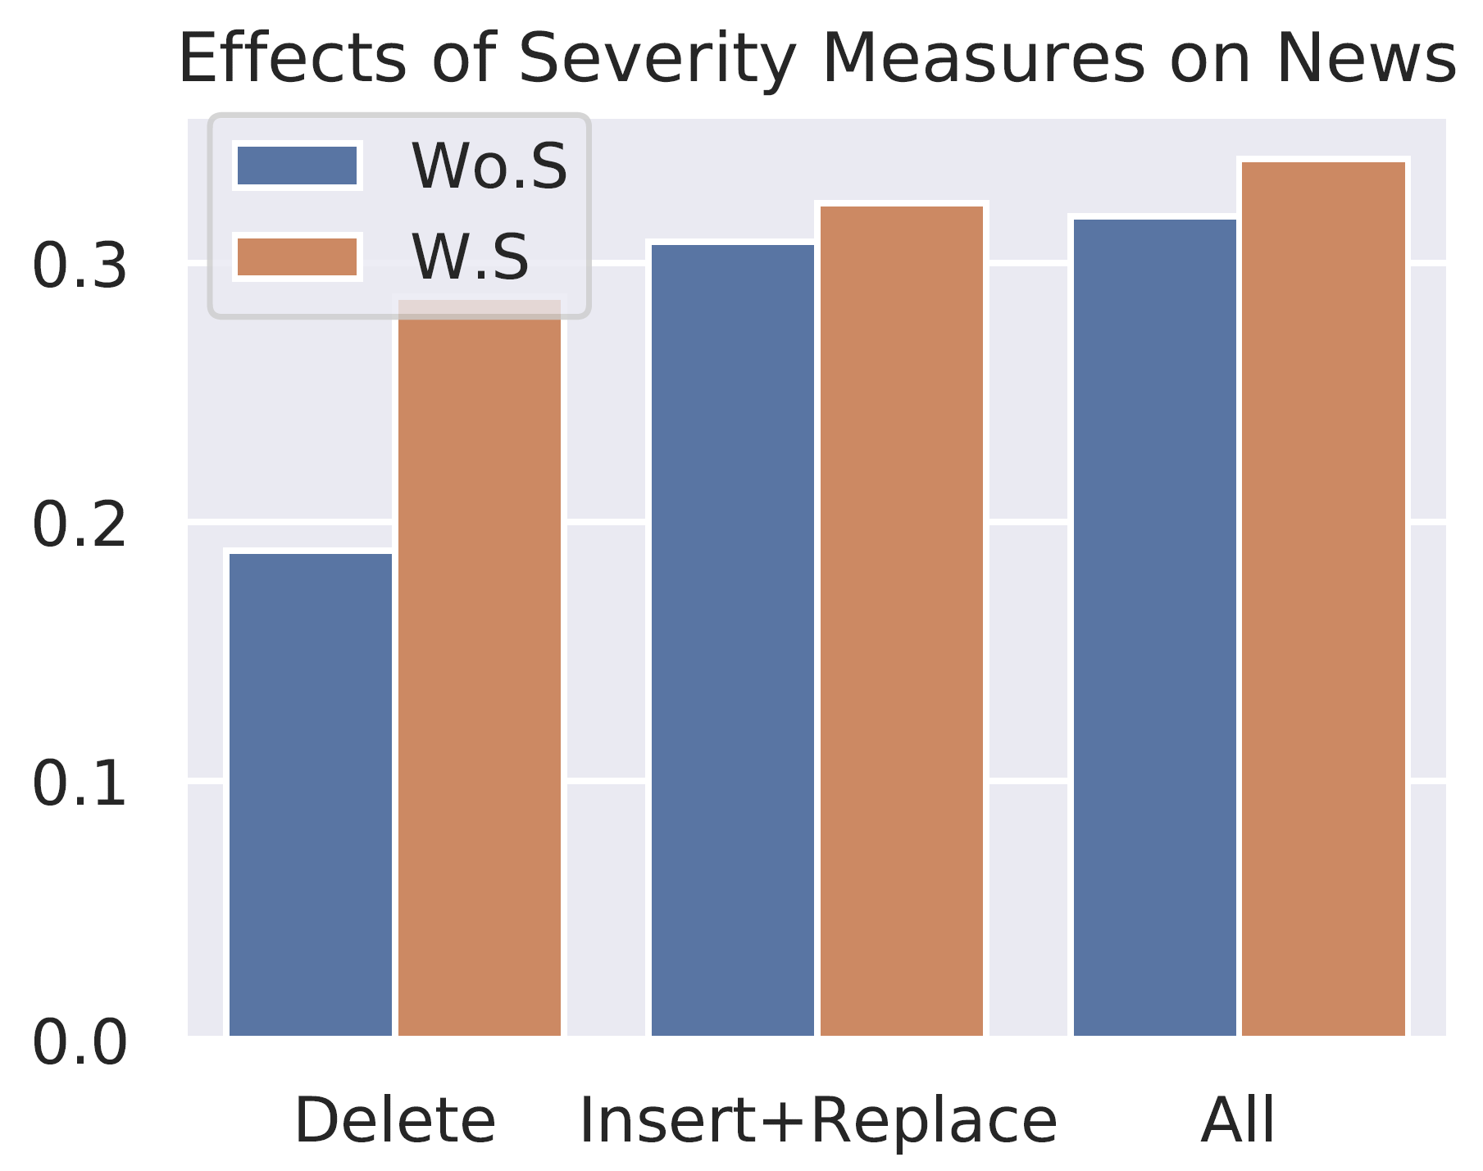
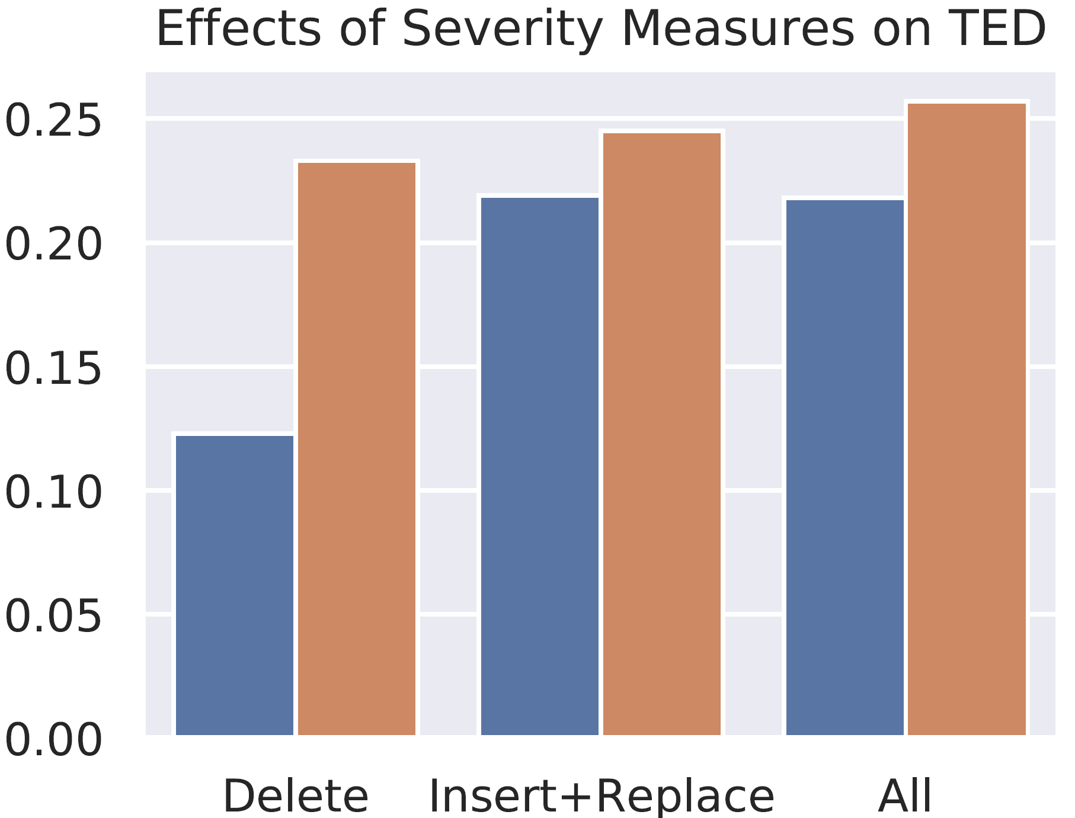
Is severity measure important to the data synthesis?

Slide 45
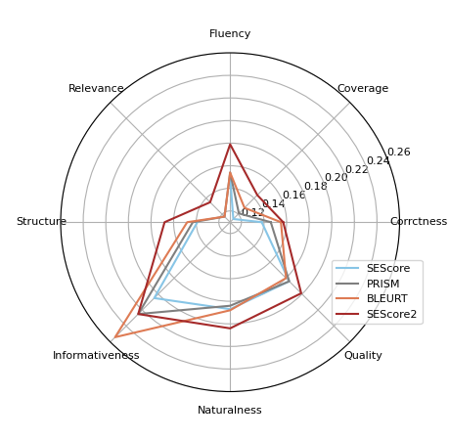
How to interpret SEScore1&2?

Slide 46
Generating Explanation for Metric
InstructScore (SEScore3), EMNLP 2023

Slide 47
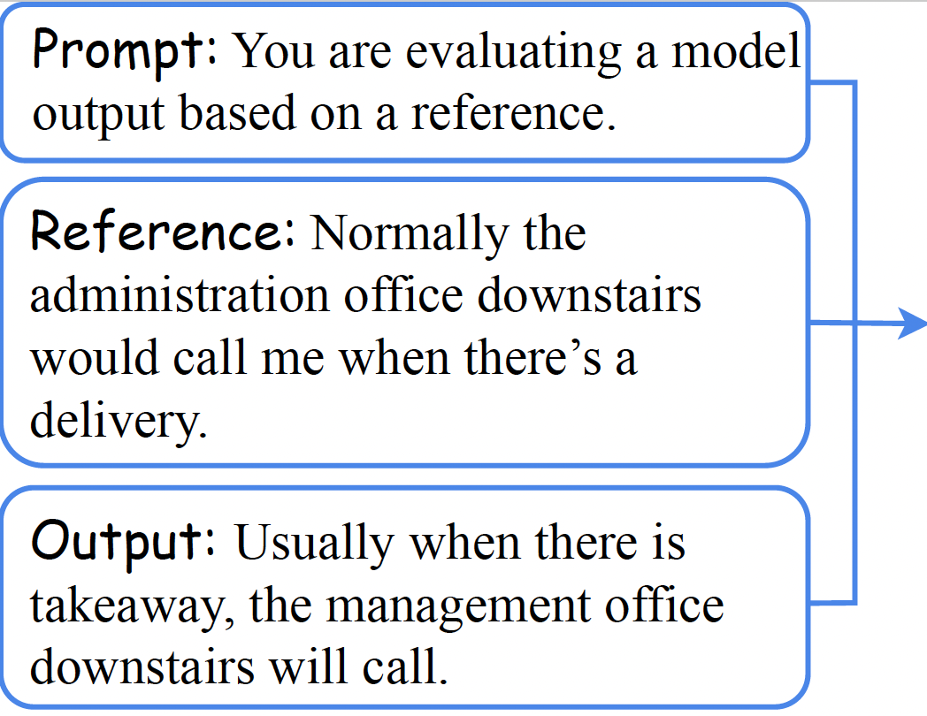
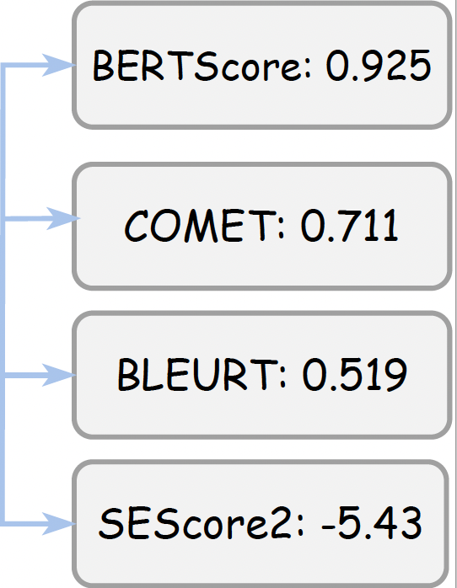

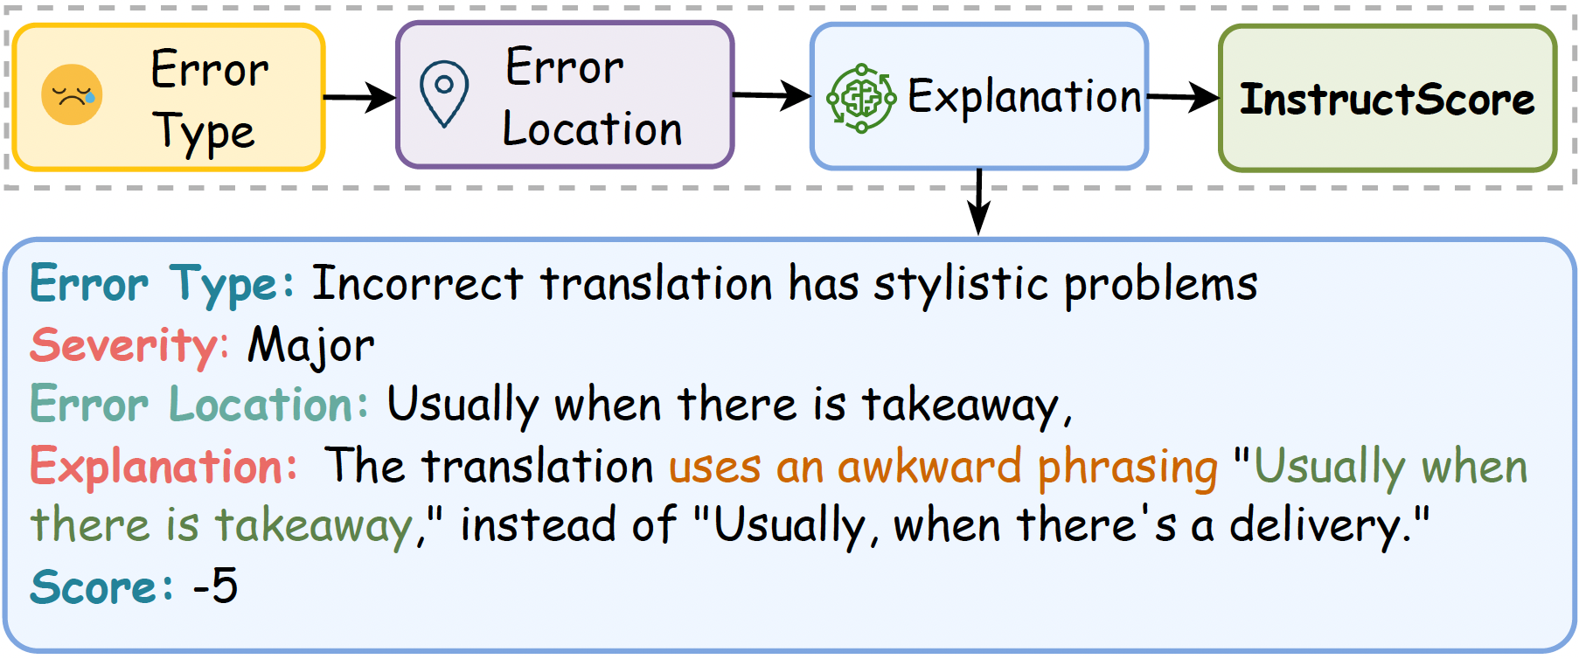
InstructScore (EMNLP 2023)
I don’t understand those scores mean? Is 0.519 good?

Slide 48
Challenges in Fine-grained Auto Evaluation of NLG
Fine-grained Explainability: Can we build an automated metric that provides natural language explanations, in addition to numerical scores?
Compact yet Competitive: Can we build a 7B model-based evaluator to beat metrics based on 175B LLMs?
No Human Annotations on Outputs for Training: Ideally, we would not want to rely on human annotations of outputs for training, so that we can adapt to different domains and tasks.

Slide 49







InstructScore Pipeline
Feed real model generated output + reference
Guided
error-and-explanation
synthesis
Q1: Is it consistent with the given error type.
Q2: Parse it into incorrect and correct phrase.
Q3: Is incorrect phrase semantically different from correct phrase? ...
Auto-identifying
Failure Modes
ii. Pass explanations with query to GPT4
GPT4
Finetune
Refinement with
Meta-Feedback
Example seed
Synthetic Data
iii. Automatic Feedback
Good: The translation uses an awkward phrasing "Usually when there is takeaway," instead of "Usually, when there's a delivery."
Bad: The translation uses " there is takeaway" instead of " there is takeaway," which alters the meaning of the sentence.
For Diagnostic output 1 (Alignment Score: 4)
A1: Yes; A2: [Usually when there is takeaway, Usually, when there's a delivery]; A3: Yes …
For Diagnostic output 2 (Alignment Score: 3)
A1: Yes; A2: [there is takeaway, there is takeaway];

Slide 50
How do we generate Synthetic Dataset
You are evaluating a model output based on a reference, which describes semantics about text.
The correct translation is, "The art of writing for educational publications…”
Please give 0 minor errors and 2 major errors.
Incorrect Translation: 【Fill in】
Error type 1: Translation includes information not present in the correct translation
Major/minor: Major
Error location 1: 【Fill in】
Explanation for error 1: 【Fill in】

Slide 51
Why not directly use GPT-4 to evaluate?
Meta-Evaluation of the Explainable Metric
Fields | Failure Mode | Description (M is local failure mode, G is global failure mode)
Error Type | Inconsistency to explanation | M1: Error type is inconsistent with explanation
Error Location | Inconsistency to explanation | M2: Error locations are not consistent with the explanation
 | Hallucination | M3: Error locations are not referred in the output text
Major/Minor | Major/Minor disagreement | M5: Major and minor labels are not correct
Explanation | Hallucination | M4: Error locations are not referred in the output text
 | Explanation failure | M6: Explanation is illogical
All 4 Fields | False negative error | G1: Error described in the explanation is not an error
 | Repetition | G2: One error is mentioned more than once among explanations
 | Phrase misalignment | G3: Incorrect phrase and correct phrase are not aligned
 | Mention multiple errors | G4: One error span mentions multiple errors

Slide 52
Here is our synthetic data
Correct translation: "The art of writing for educational publications involves striking a delicate balance between providing enough detail to be useful and overwhelming the reader with too much information."
Incorrect Translation: "Waiting for educational publications is about finding a balance between giving enough examples to be useful and making the reader bored with too many details."
Error type 1: Translation includes information not present in the correct translation
Major/minor: Major
Error location 1: "...giving enough examples..."
Explanation for error 1: The correct translation talks about providing enough detail, not specific examples, which changes the meaning of the sentence.

Slide 53
Direct Knowledge Distillation can tigger failure modes!
Reference: A series of creative academic achievements were awarded at the opening ceremony of the 2016 Annual Academic Conference of Zhejiang University.
Output: At the opening ceremony of the 2016 academic annual meeting of Zhejiang University, a series of academic achievements were recognized.
Error type 3: Wrong word choice
Major/minor: Minor
Error location 3: "academic annual meeting"
Explanation for error 3: The incorrect translation adds the word "annual" to the phrase "academic meeting," which is not present in the correct translation. However, this does not significantly change the meaning of the sentence.
M1: Error type is inconsistent with explanation

Slide 54
Direct Knowledge Distillation can tigger failure modes!
Reference: A series of creative academic achievements were awarded at the Annual Academic Conference of Zhejiang University.
Output: At the academic annual meeting of Zhejiang University, a series of academic achievements were recognized.
Error type 3: Incorrect translation includes information not present in the correct translation
Major/minor: Minor
Error location 3: "Zhejiang University"
Explanation for error 3: The incorrect translation adds the word "annual" to the phrase "academic meeting," which is not present in the correct translation. However, this does not significantly change the meaning of the sentence.
M2: Error locations are not consistent with the explanation

Slide 55
Direct Knowledge Distillation can tigger failure modes!
Reference: A series of creative academic achievements were awarded at the Annual Academic Conference of Zhejiang University.
Output: At the academic annual meeting of Zhejiang University, a series of academic achievements were recognized.
Error type 3: Incorrect translation includes information not present in the correct translation
Major/minor: Minor
Error location 3: "Annual Academic Conference"
Explanation for error 3: The incorrect translation adds the word "annual" to the phrase "academic meeting," which is not present in the correct translation. However, this does not significantly change the meaning of the sentence.
M3: Error locations are not referred in the output text

Slide 56
Direct Knowledge Distillation can tigger failure modes!
Reference: A series of creative academic achievements were awarded at the Annual Academic Conference of Zhejiang University.
Output: At the academic annual meeting of Zhejiang University, a series of academic achievements were recognized.
Error type 3: Incorrect translation includes information not present in the correct translation
Major/minor: Minor
Error location 3: "academic annual meeting"
Explanation for error 3: The incorrect translation contains “Annual Academic Conference”, which is the incorrect translation.
M4: Error locations are not consistent with the explanation

Slide 57
Direct Knowledge Distillation can tigger failure modes!
Reference: A series of creative academic achievements were awarded at the Annual Academic Conference of Zhejiang University.
Output: At the academic annual meeting of Zhejiang University, a series of academic achievements were recognized.
Error type 3: Incorrect translation includes information not present in the correct translation
Major/minor: Major
Error location 3: "academic annual meeting"
Explanation for error 3: The incorrect translation adds the word "annual" to the phrase "academic meeting," which is not present in the correct translation. However, this does not significantly change the meaning of the sentence.
M5: Major and minor labels are not correct

Slide 58
Direct Knowledge Distillation can tigger failure modes!
Reference: A series of creative academic achievements were awarded at the Annual Academic Conference of Zhejiang University.
Output: At the academic annual meeting of Zhejiang University, a series of academic achievements were recognized.
Error type 3: Incorrect translation includes information not present in the correct translation
Major/minor: Minor
Error location 3: "academic annual meeting"
Explanation for error 3: The incorrect translation adds the word "annual" to the phrase "academic meeting," which is not present in the correct translation. However, this does not significantly change the meaning of the sentence.
M6: Explanation is illogical

Slide 59
Direct Knowledge Distillation can tigger failure modes!
Reference: A series of creative academic achievements were awarded at the Annual Academic Conference of Zhejiang University.
Output: At the academic annual meeting of Zhejiang University, a series of academic achievements were recognized.
Error type 3: Word Choice
Major/minor: Minor
Error location 3: "Zhejiang University"
Explanation for error 3: The use of Zhejiang university is wrong. This is not the right entity
G1: Error described in the explanation is not an error

Slide 60
Use GPT-4 as a reward model
Reference: …… the revolutionary base area of south Jiangxi.
Output: ……the old revolutionary district of southern Jiangxi.
revolutionary base area
Error location 1: "old revolutionary district"
Error type 1: Terminology is non-standard or does not fit the context. Terminology is used inconsistently
Explanation 1: The correct term should be “revolutionary base area" which refers to the area where the revolution started in 1927, not "old revolutionary district" which does not convey the same meaning.
……
old revolutionary district

Slide 61
Use GPT-4 as a reward model
Reference: …… the revolutionary base area of south Jiangxi.
Output: ……the old revolutionary district of southern Jiangxi.
Correct: revolutionary base area
Error location 1: "old revolutionary district"
Error type 1: Terminology is non-standard or does not fit the context. Terminology is used inconsistently
Explanation 1: The correct term should be “revolutionary base area" which refers to the area where the revolution started in 1927, not "old revolutionary district" which does not convey the same meaning.
……
Incorrect: old revolutionary district

Slide 62
Use GPT-4 as a reward model
Reference: …… the revolutionary base area of south Jiangxi.
Output: ……the old revolutionary district of southern Jiangxi.
Does output contain this error?
Correct: revolutionary base area
Are two phrase aligned?
Incorrect: old revolutionary district
Decide if severity label is accurate?
Is the error type consistent?
Terminology is non-standard
Major

Slide 63
Use GPT-4 as a reward model
Q1: extract the incorrect error location. A1:
Reference: …… the revolutionary base area of south Jiangxi.
Output: ……the old revolutionary district of southern Jiangxi.
Q2: Parse the phrase of explanation to [incorrect, correct], [incorrect, None], [None, correct], or [None, None]. A2:
Q3: If A2 is "incorrect to correct", is A2 a correct alignment for reference and output? A3:
Error location 1: "old revolutionary district"
Error type 1: Terminology is non-standard or does not fit the context. Terminology is used inconsistently
Explanation 1: The correct term should be "new revolutionary base area" which refers to the area where the revolution started in 1927, not "old revolutionary district" which does not convey the same meaning.
……
Q4: if A2 is "incorrect to correct" and incorrect and correct phrases can be used interchangeably, it is no-error. Answer, no-error or minor-error or major-error. A4:
Q5: Is the explanation consistent with the given error type? A5:
Q6: Does the explanation include the error location? A6:
Q7: Do two error locations mention the same location? How many pairs of repetitions? (Answer in a number) A7: Yes/No, number

Slide 64
GPT-4’s Feedback
Error 1:
A1: "old revolutionary district"
A2: ["old revolutionary district", "revolutionary base area"]
A3: "Yes"
A4: "major-error"
A5: "Yes"
A6: "Yes",
Error 2:
A1: "dominant"
A2: ["dominant","privileged"]
A3: "Yes"
A4: "minor-error"
A5: "Yes"
A6: "Yes"
A7: "No, 0"
Reference: …… the revolutionary base area of south Jiangxi.
Output: ……the old revolutionary district of southern Jiangxi.
Error location 1: "old revolutionary district"
Error type 1: Terminology is non-standard or does not fit the context. Terminology is used inconsistently
Explanation 1: The correct term should be "new revolutionary base area" which refers to the area where the revolution started in 1927, not "old revolutionary district" which does not convey the same meaning.

Slide 65
GPT-4’s Feedback
Error1
Error location1: 1/1
Error type1: 1/1
Major/Minor: 1/1
Explanation: 1/1
Error2
Error location1: 1/1
Error type1: 1/1
Major/Minor: 0/1
Explanation: 1/1
Reference: …… the revolutionary base area of south Jiangxi.
Output: ……the old revolutionary district of southern Jiangxi.
Error location 1: "old revolutionary district"
Error type 1: Terminology is non-standard or does not fit the context. Terminology is used inconsistently
Explanation 1: The correct term should be "new revolutionary base area" which refers to the area where the revolution started in 1927, not "old revolutionary district" which does not convey the same meaning.
Alignment Score: 7/8

Slide 66
Robust Performance across Tasks (Five NLG tasks)

Slide 67
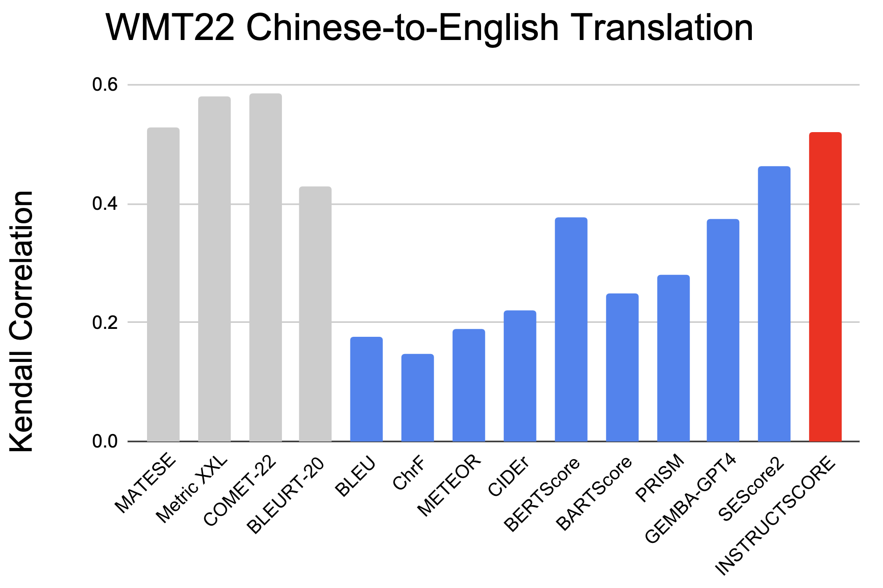
InstructScore can judge machine translation!
Supervised metrics
Unsupervised metrics
Unsupervised InstructScore

Slide 68
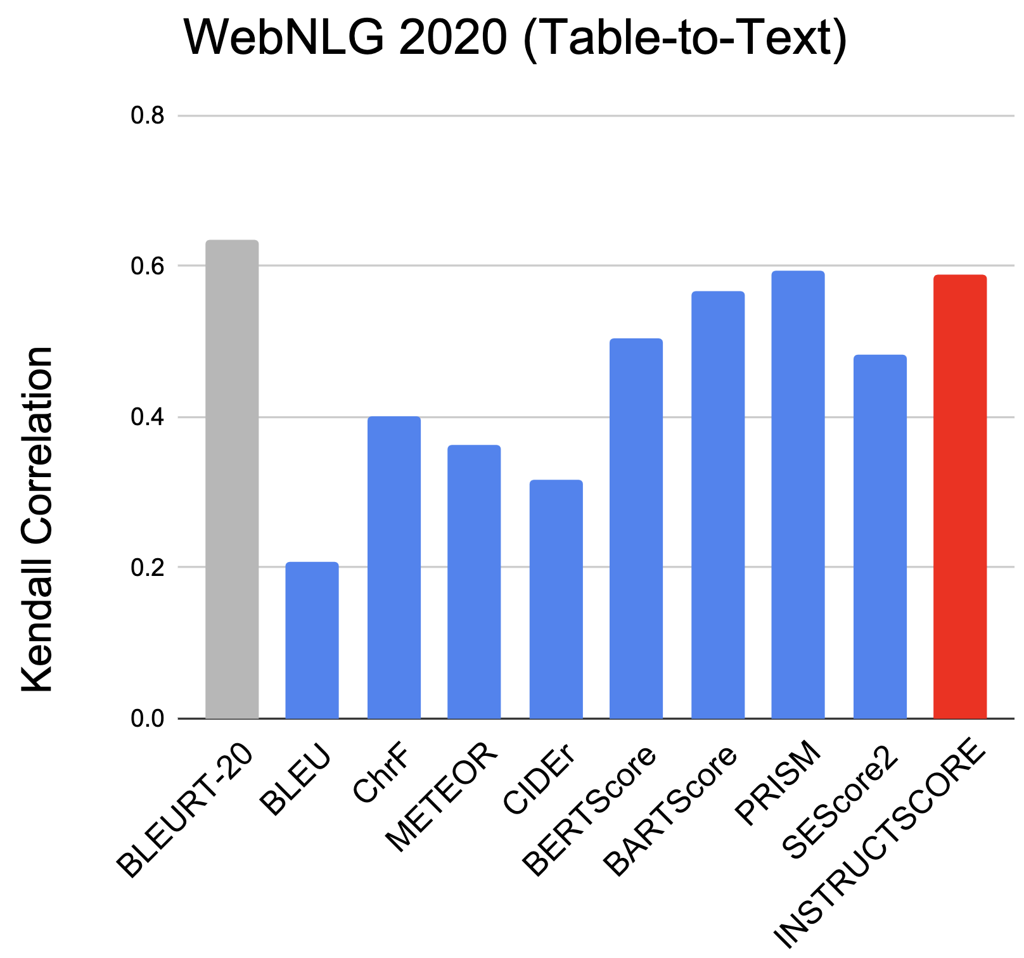
InstructScore can judge structure data-to-text!
Supervised metrics
Unsupervised metrics
Unsupervised InstructScore

Slide 69
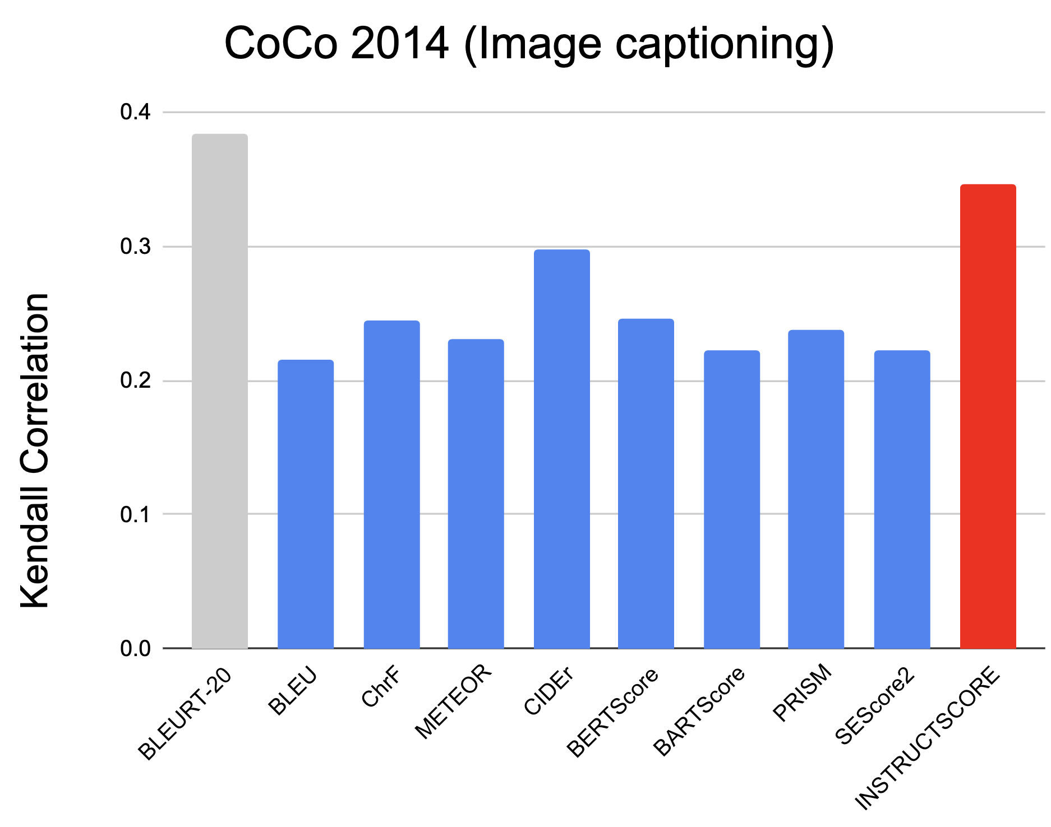
InstructScore can judge image captioning!
Supervised metrics
Unsupervised metrics
Unsupervised InstructScore

Slide 70
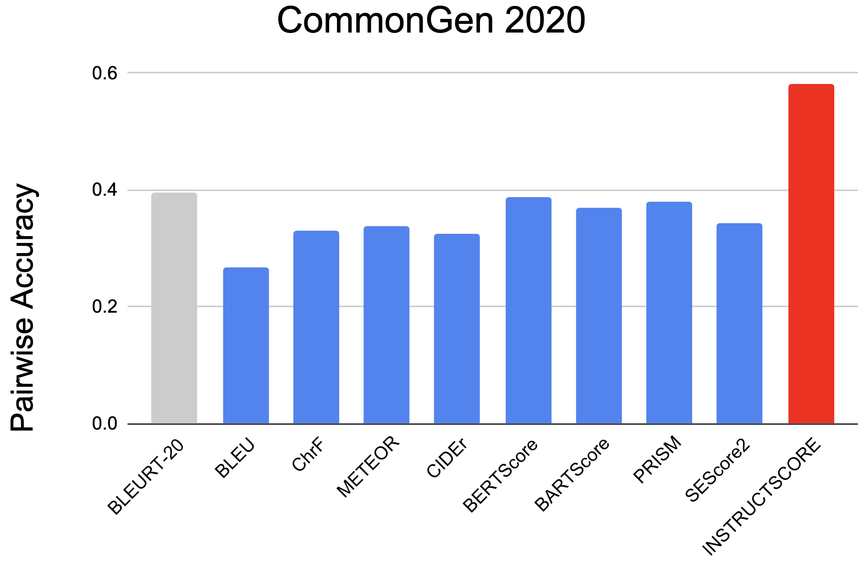
InstructScore can judge commonsense generation!
Supervised metrics
Unsupervised metrics
Unsupervised InstructScore

Slide 71
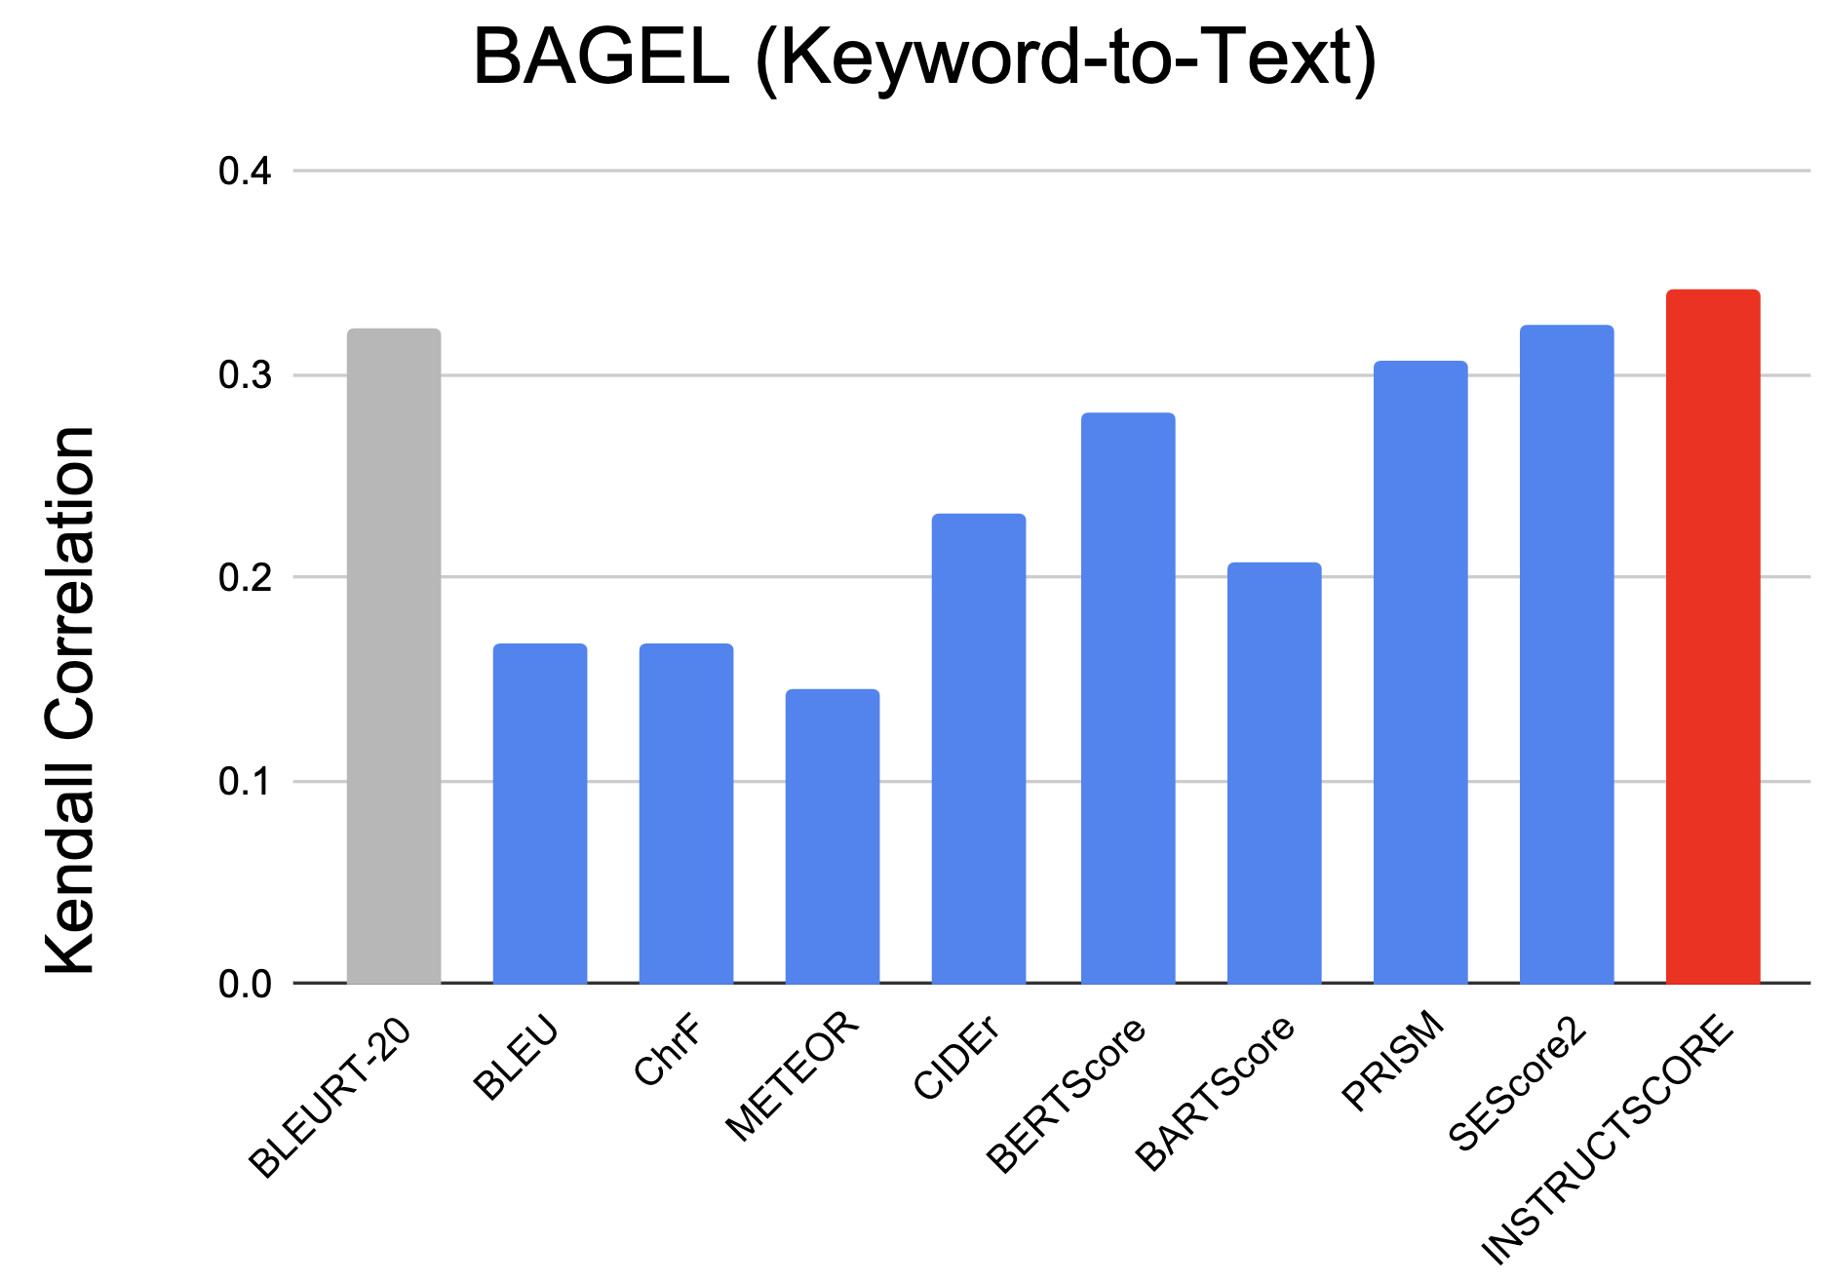
InstructScore can judge unseen keyword-to-text generation!
Supervised metrics
Unsupervised metrics
Unsupervised InstructScore

Slide 72
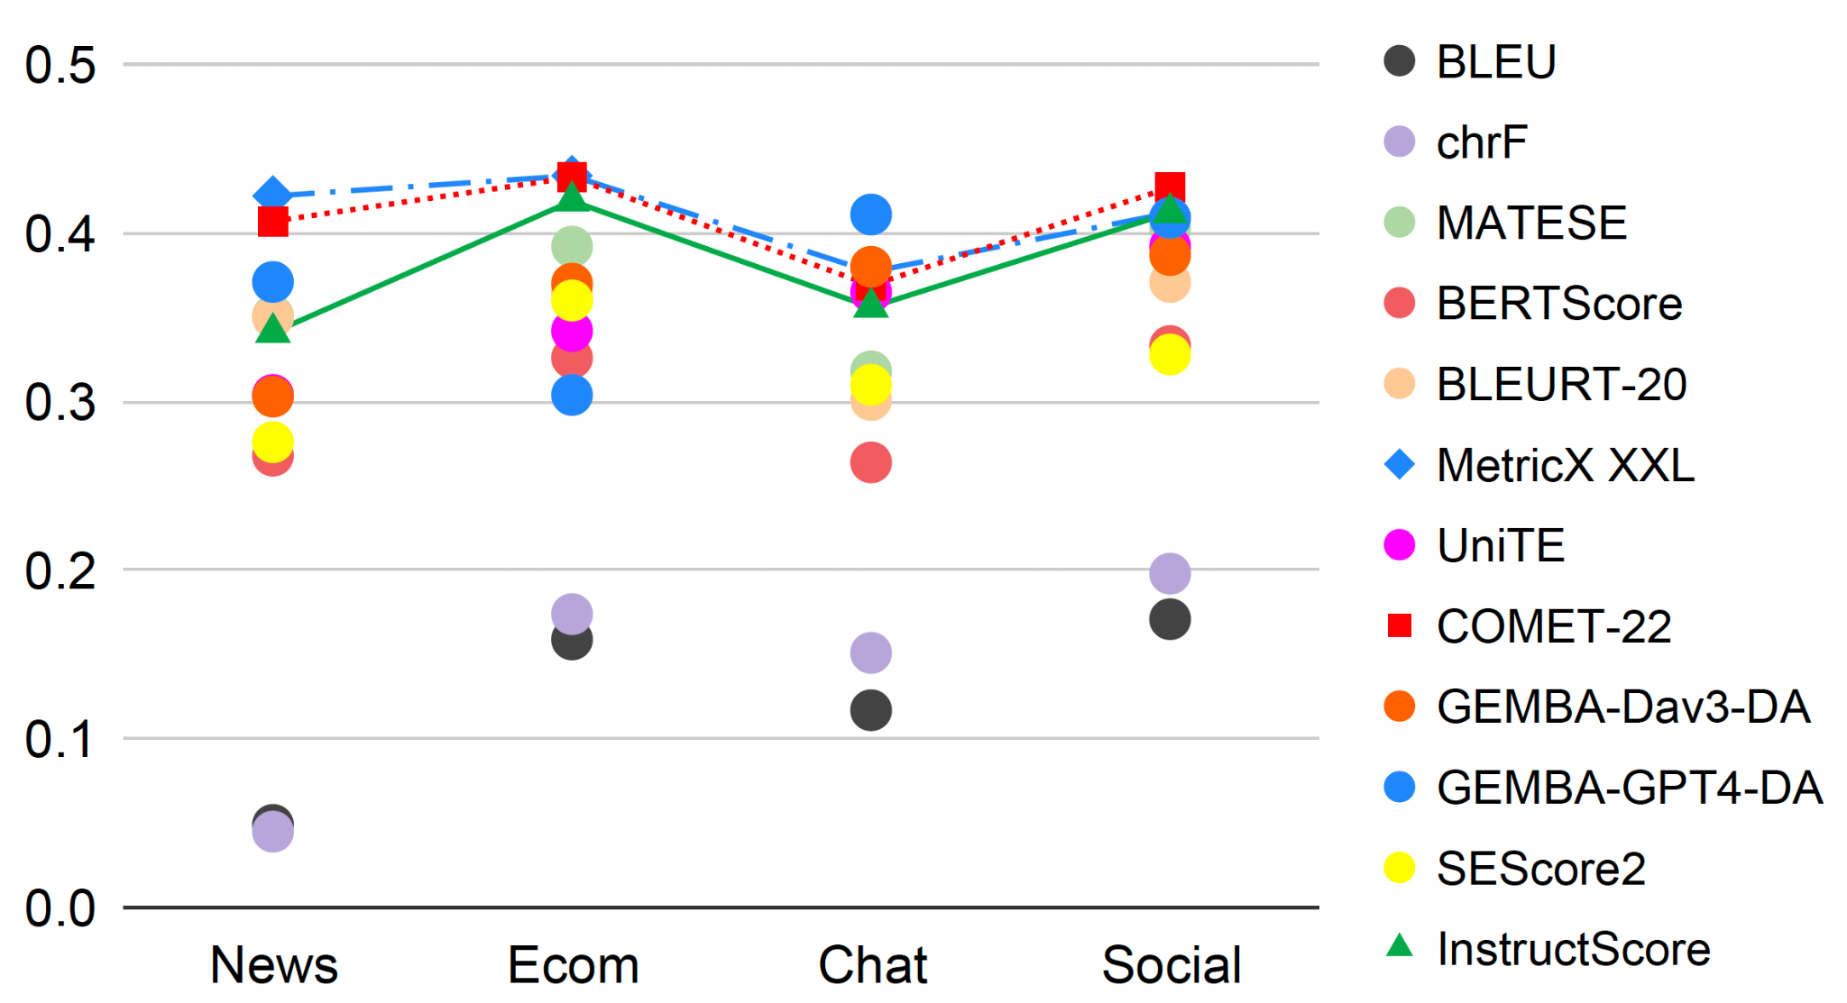
Robust Performance across Domains (WMT22 Zh-En)

Slide 73
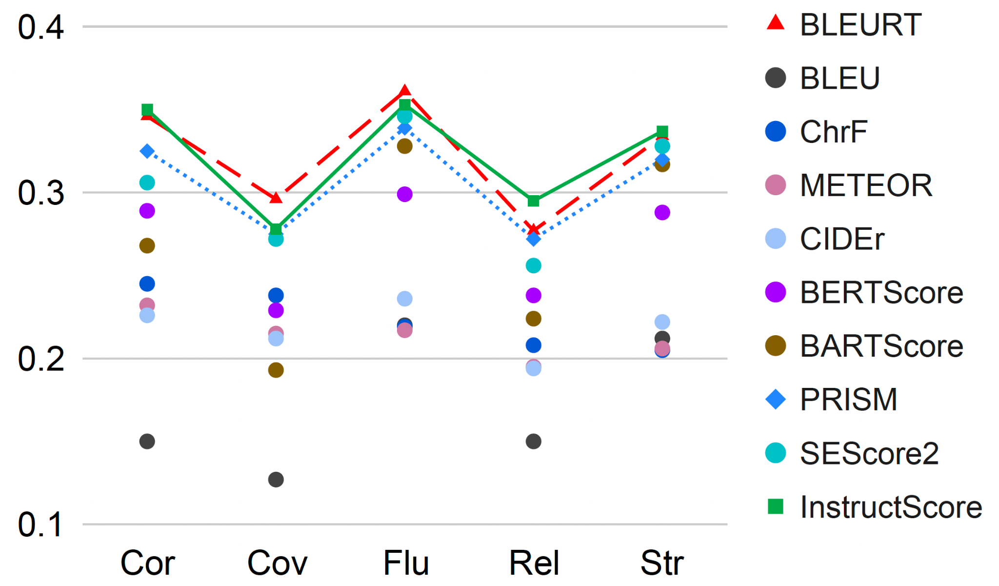
Robust Performance across Dimensions (WebNLG20)
Notes:
Correlation, coverage, fluency, relevance, structure.

Slide 74
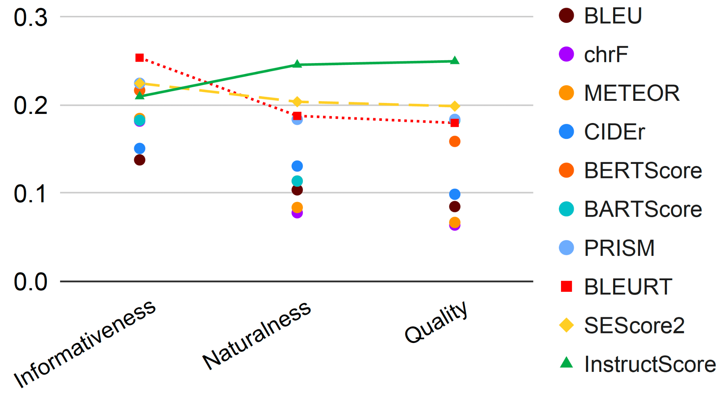
Generalization under Unseen Task (BAGEL D2T)

Slide 75
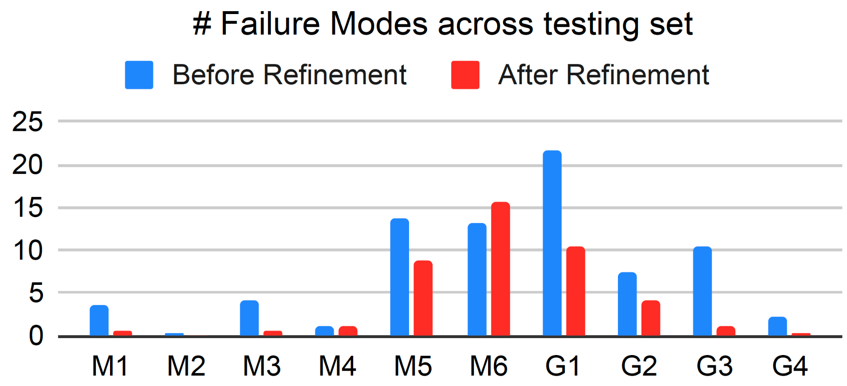
Automatic critique and Self-training can improve human alignments
Precision = # correct fields / total # annotated fields by InstructScore
Recall = # correct fields / total # annotated fields by human
InstructScore | Precision | Recall | Human
Finetune | 0.778 | 0.824 | 0.773
Finetune+Refinement | 0.894 | 0.856 | 0.879
We reduce G1 from 22 to 11 across 100 examples

Slide 76
Our Refinement can improve InstructScore Feedback
Reference: Washing hands with air, diagnosing disease through breath, and accurately seeking for source of smog; last night…
Output: Wash hands with air, judge diseases, accurately search for the source of fog Yesterday evening…
Error type 3: Incorrect translation includes information not present in the correct translation
Major/minor: Minor
Error location 3: "academic annual meeting"
Explanation for error 3: The incorrect translation adds the word "annual" to the phrase "academic meeting," which is not present in the correct translation.
Error type 3: Incorrect translation does not accurately represent the correct translation
Major/minor: Minor
Error location 3: "academic annual meeting"
Explanation for error 3: The incorrect translation uses "academic annual meeting" instead of "academic annual conference,"

Slide 77
Key Advantages of InstructScore
Compact yet competitive
Explainability
Easy to use
Generalizability (No human ratings are required!)
We develop a new model-based evaluation metric for Explainable text generation-based metric and leverage automatic feedback to align with human requirements!

Slide 78
Future Direction
Use fine-grained feedback to guide text generation
Better incorporate human rating data and synthetic data
Extend InstructScore to source-based setting and multilingual setting

Slide 79
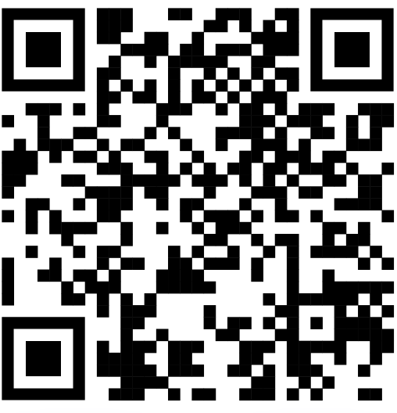
SEScore/InstructScore
Arxiv: https://arxiv.org/abs/2305.14282
Github: https://github.com/xu1998hz/SEScore3
HuggingFace: https://huggingface.co/xu1998hz/InstructScore

